Slide 1
Zomato Order & Restaurant Analysis Using Power BI
Presented by Shaik Arshiya Fathima

Slide 2
Perform Simple Data Transformations Using SQL :-
I performed basic data cleaning and there are no duplicate records and no Null Values.
In this there are total 5 cities and each city holds the following restaurants,they are: Mumbai-115,Bangalore-109,Delhi-93,Kolkata-92,Chennai-91.
The top 5 cities with highest no.of orders are: Mumbai,Bangalore,Delhi,Kolkata,Chennai.
The top 5 Restaurants with total sales are restuarant_116,262,56,27,127.

Slide 3
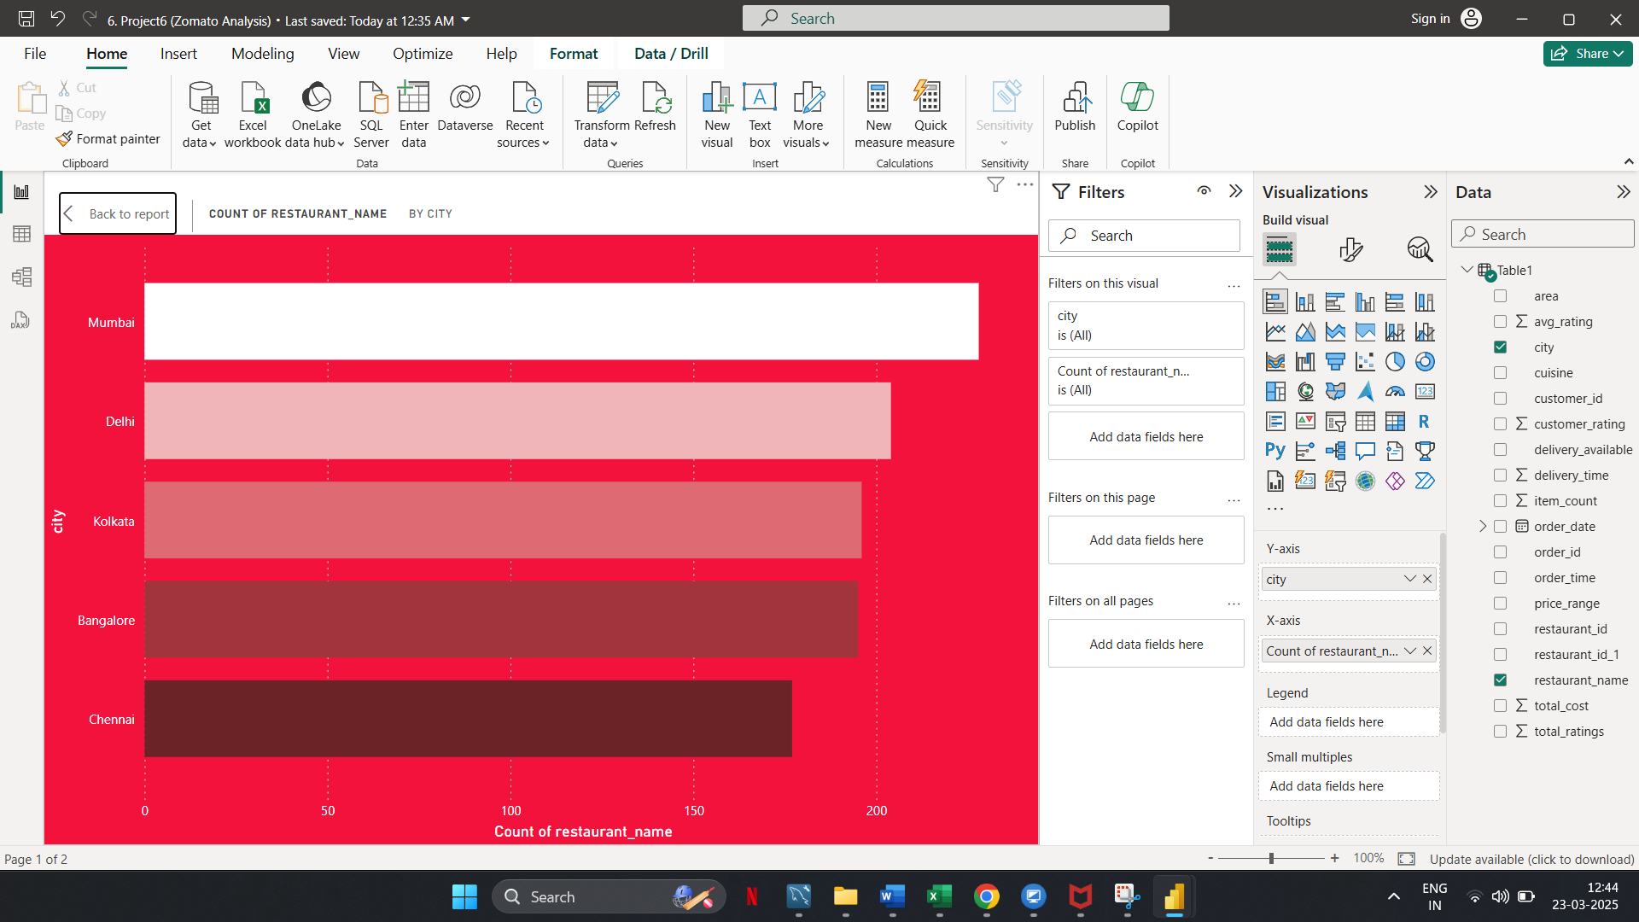
Power BI tasks
🔹 Task 1: Number of Restaurants per City
Observation: Mumbai has the highest number of restaurants, followed by Delhi, Kolkata, Bangalore, and Chennai.

Slide 4
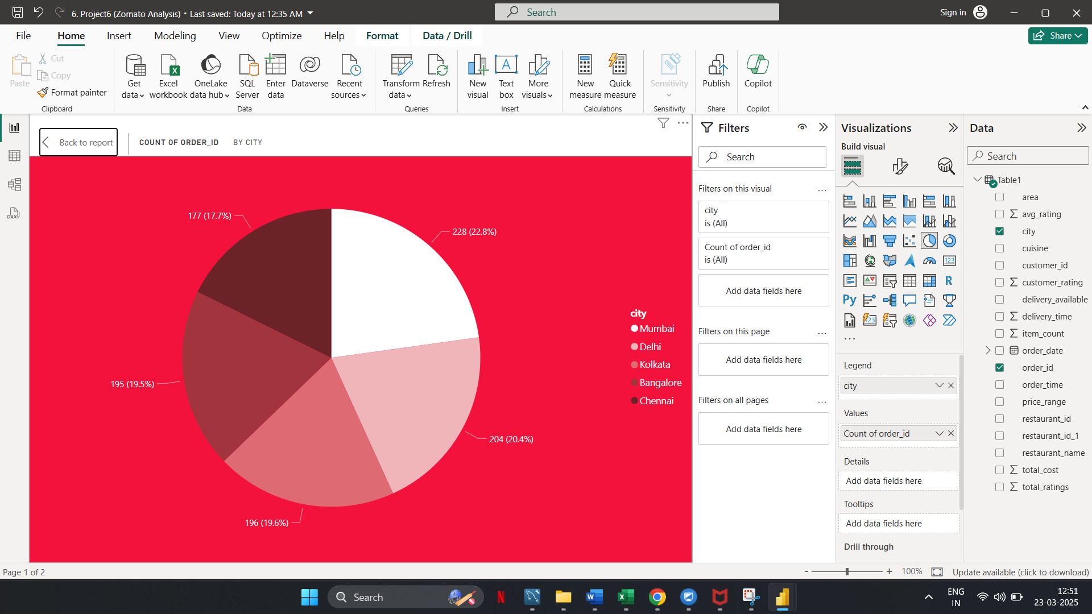
Power BI tasks
🔹 Task 2: Percentage of Orders from Different Cities
Observation: Mumbai has the highest percentage of orders, followed by Delhi and Kolkata.

Slide 5
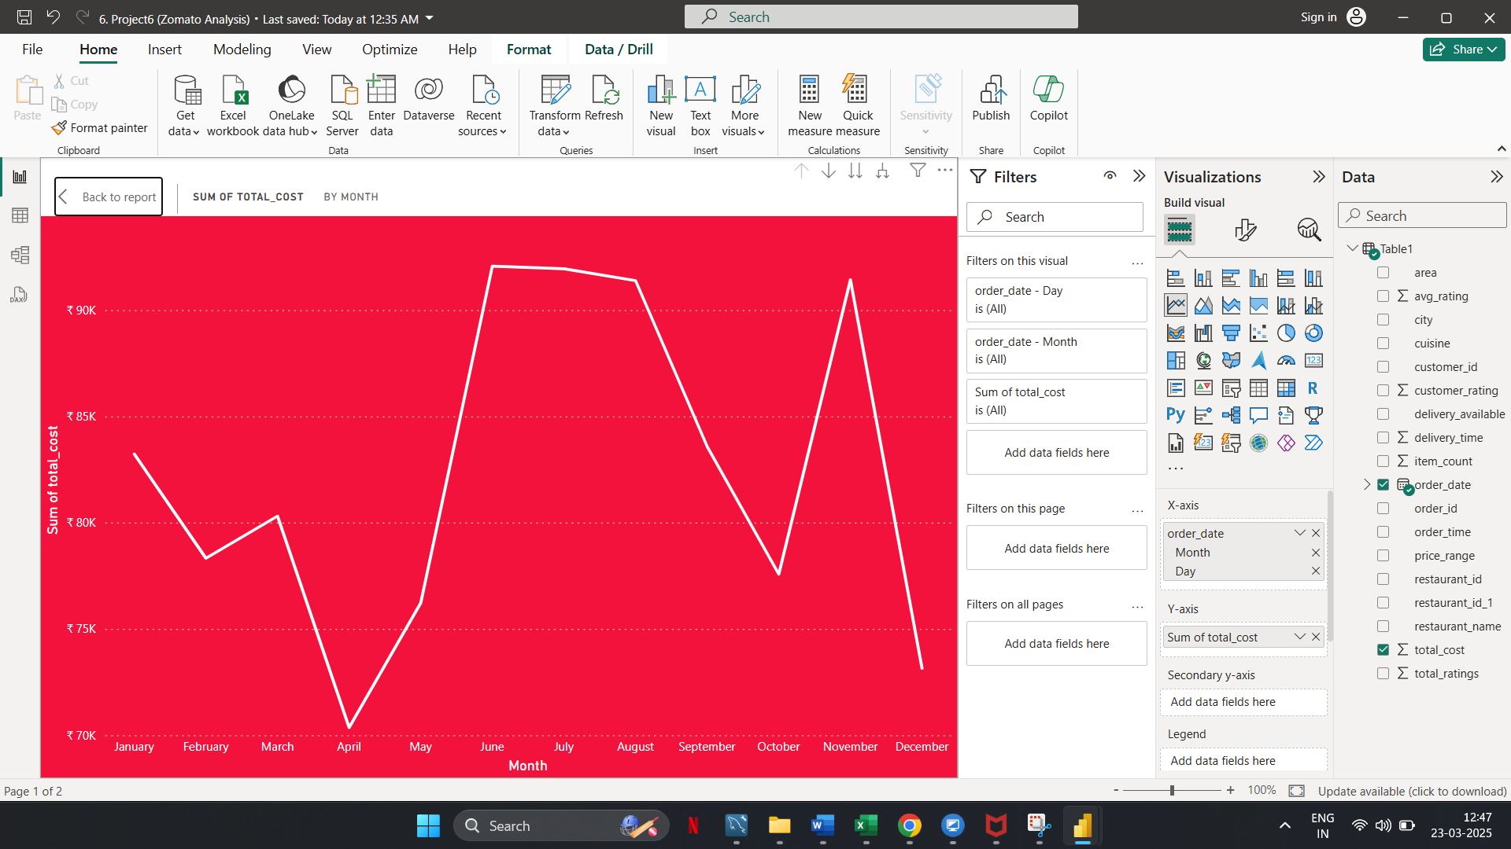
Power BI tasks
🔹 Task 3: Order Amount Trends Over Time
Observation: The total cost fluctuates across months, with noticeable peaks and dips.

Slide 6
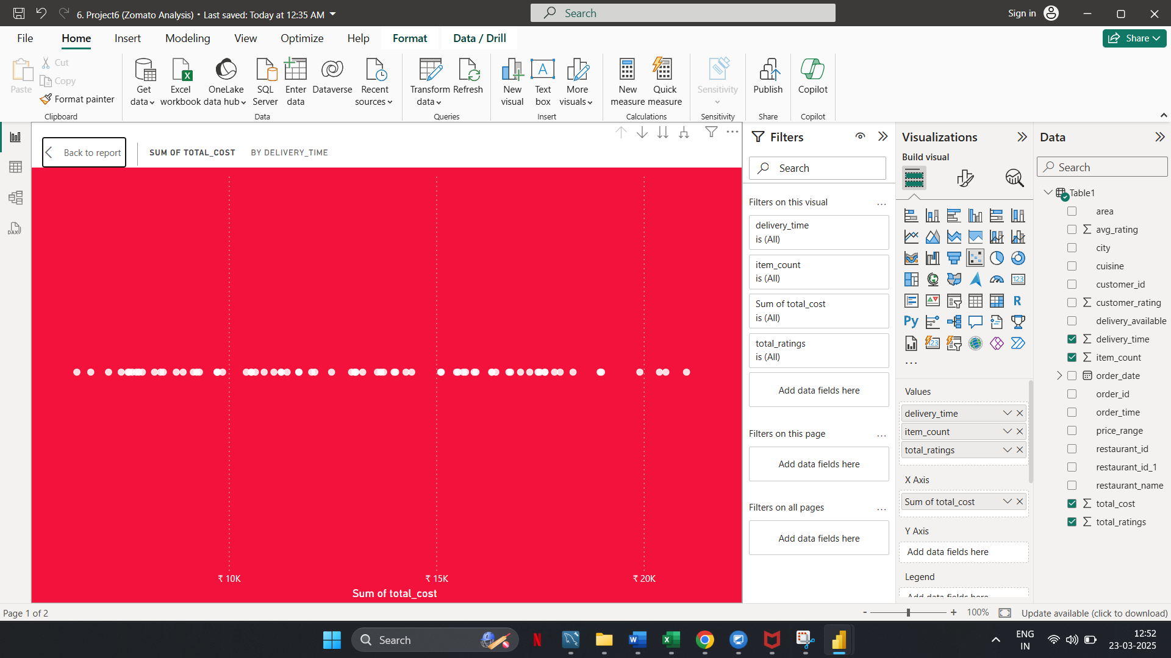
Power BI tasks
🔹 Task 4: Correlation of Factors Affecting Average Rating
Observation: Most orders have a total cost concentrated in a particular range.

Slide 7
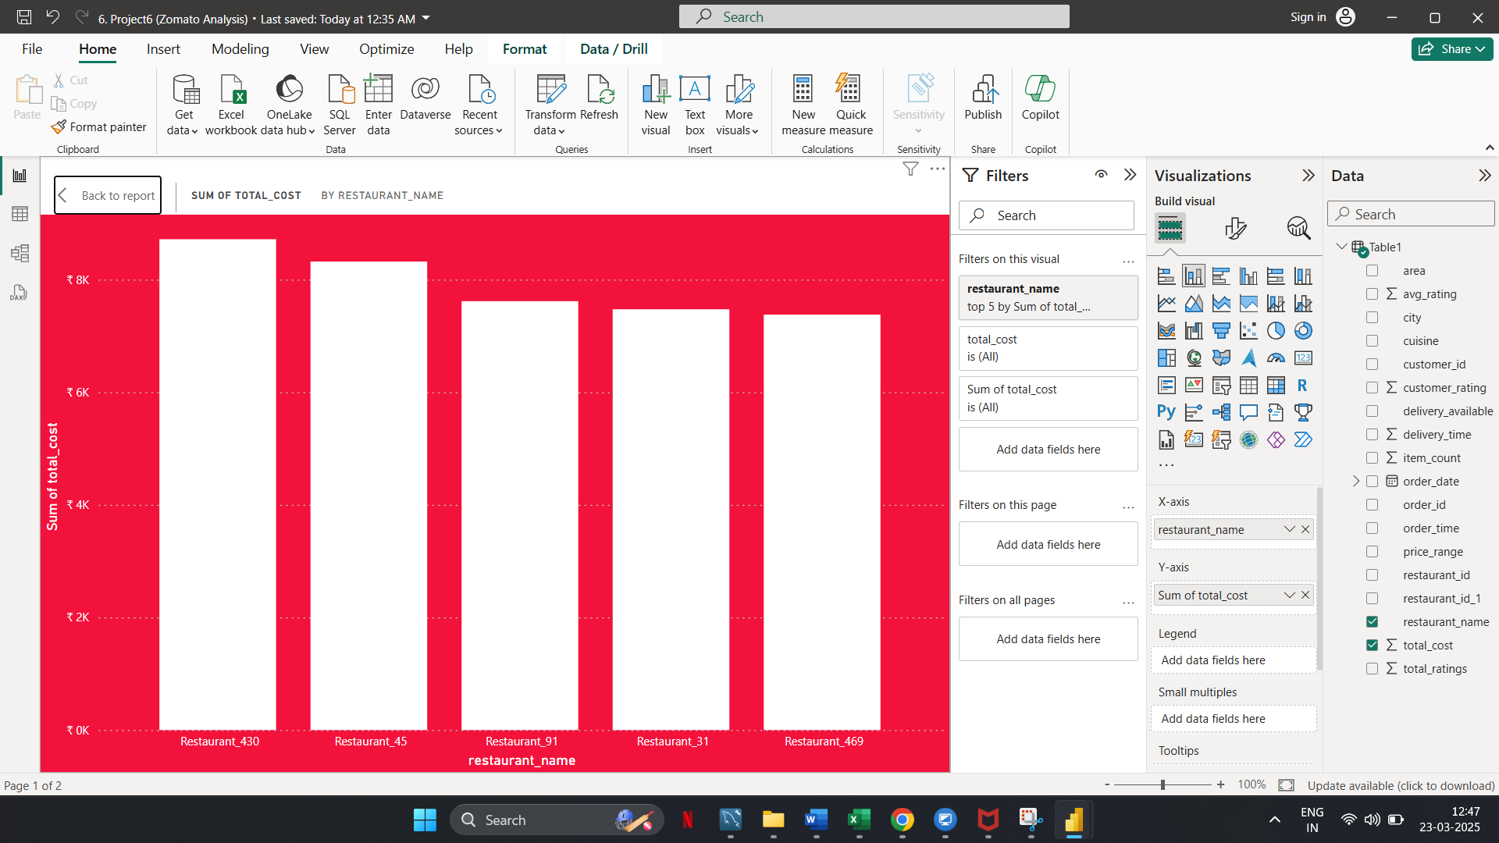
Power BI tasks
🔹 Task 5: Top 5 Restaurants by Total Sales
Observation: A few restaurants contribute significantly to the total revenue.

Slide 8
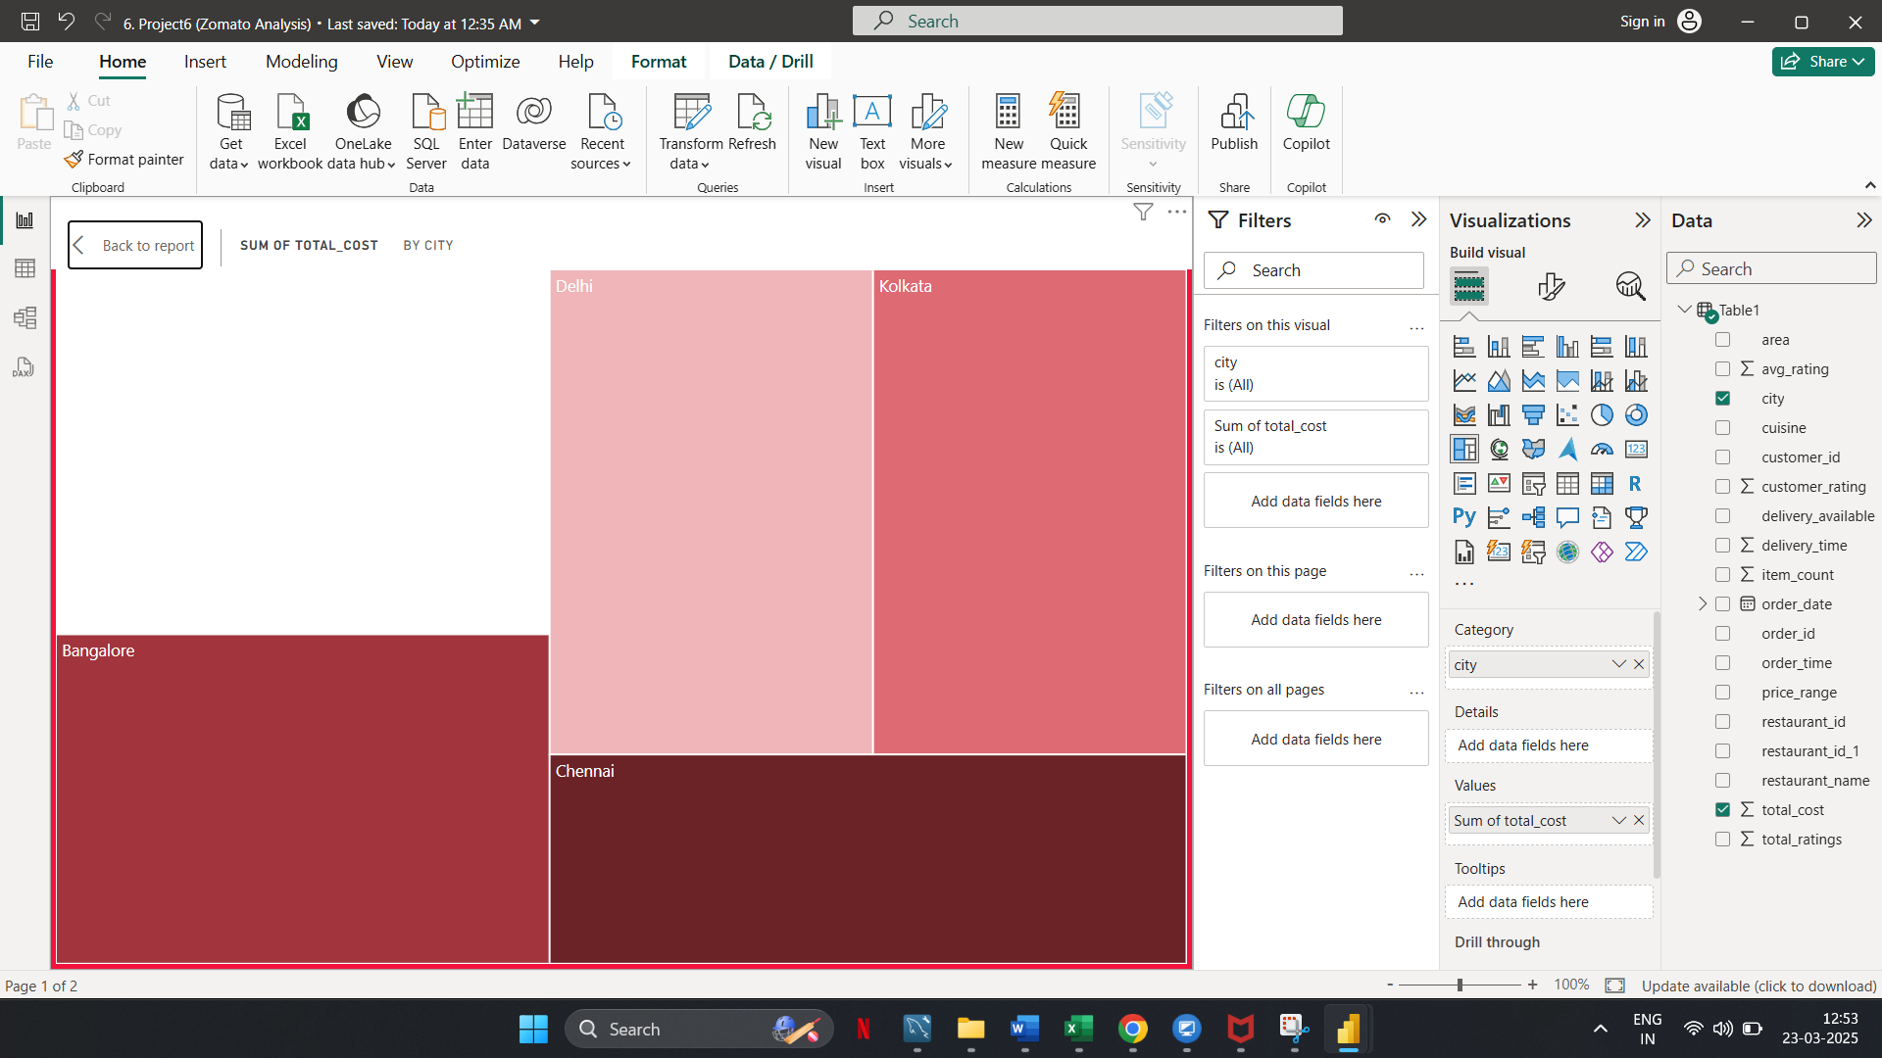
Power BI tasks
🔹 Task 6: Revenue by Area Using a Tree Map
Observation: Kolkata appears to contribute significantly to total costs, while other cities are lower.

Slide 9
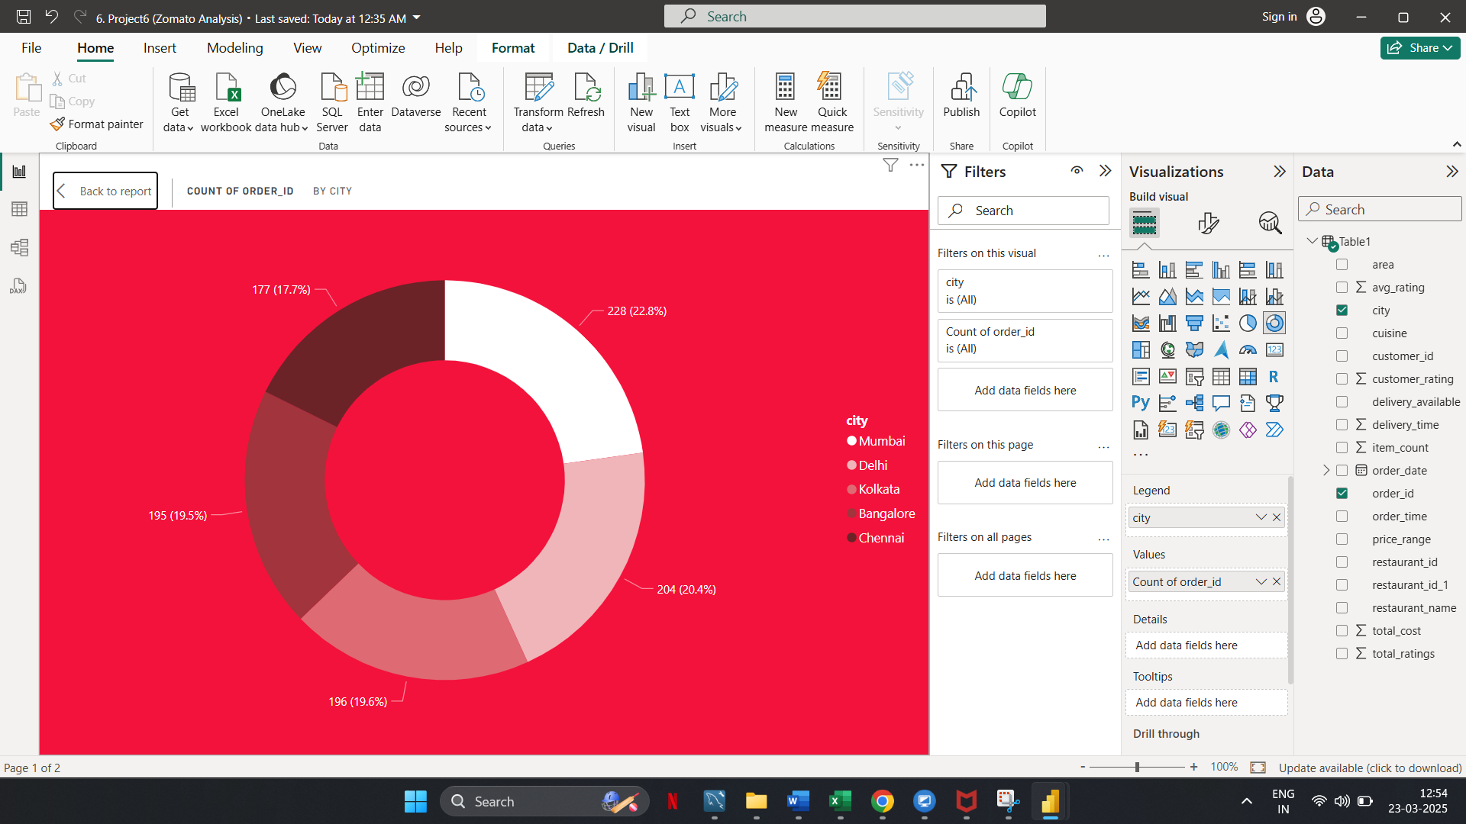
Power BI tasks
🔹 Task 7: Order Density by City Using a Heat Map
Observation: Mumbai has the highest percentage of orders, followed by Delhi and Kolkata.

Slide 10
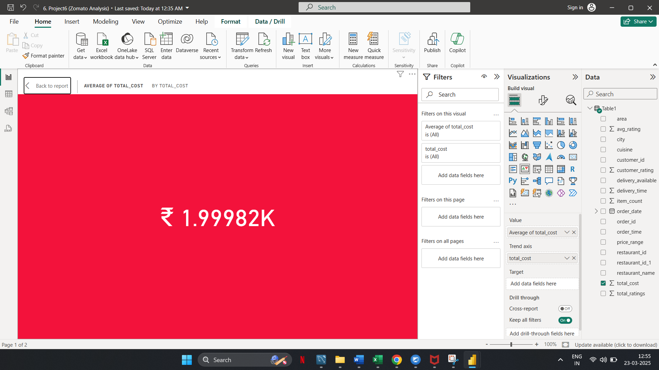
Power BI tasks
🔹 Task 8: KPI Cards – Total Revenue & Average Order Value
Observation: The average total cost per order is ₹1.99982K.

Slide 11
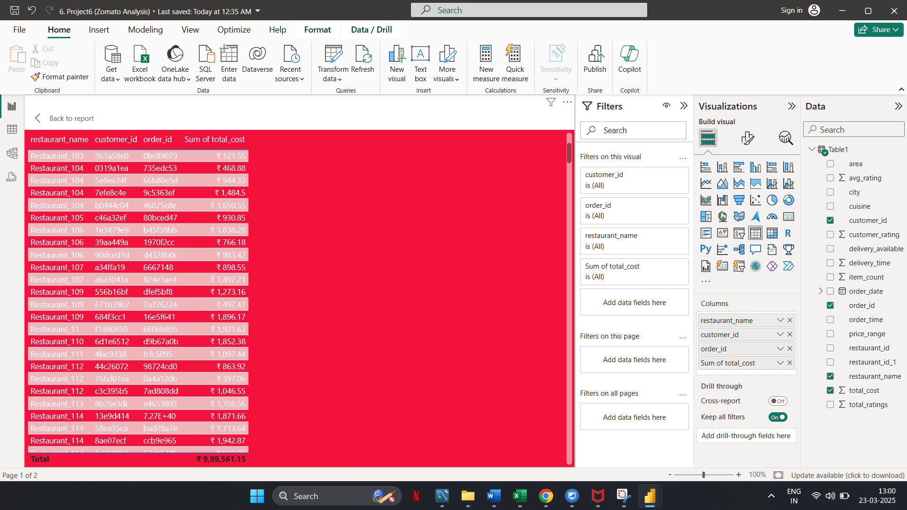
Power BI tasks
🔹 Task 9: Restaurant-Wise Sales Summary in a Table
Observation: Displays individual restaurant, customer, and order details.

Slide 12
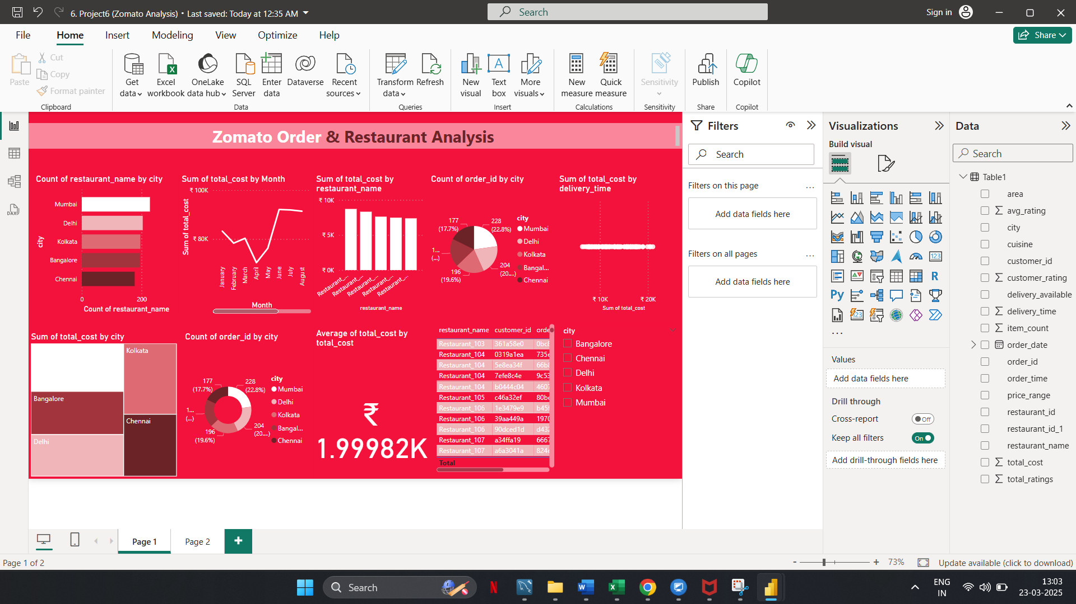
Power BI tasks
🔹 Task 10: Power BI Dashboard – Combining All Visuals

Slide 13
Recommendations
Increase restaurant onboarding in cities with fewer restaurants but high order demand.
Promote high-performing restaurants and provide support to underperforming ones.
Ensure sufficient delivery resources in high-order cities to maintain efficiency.
Optimize delivery efficiency if longer delivery times lead to lower order values.
Conduct a deeper analysis of customer spending behavior to tailor pricing strategies.
Compare average total cost with industry benchmarks and adjust pricing strategies if needed.
Utilize customer and order data for segmentation and personalized marketing campaigns.

